Slide 1
GDPR

Slide 2
GDPR :
The European Union’s new Privacy law -→ the General Data Protection Regulation- Came into effect on May 25, 2018
This new Regulation applies to the data of all EU Citizens, irrespective of Where Data is stored or sent to(Even if you are sending data from the US to the recepients in the EU
Consistent and Enforcable legal requirments across all member states to protect the right of any EU Citizen to privacy and security of their personal data

Slide 3
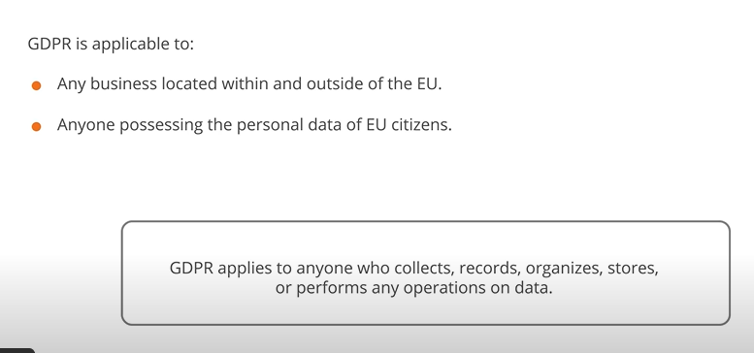

Slide 4
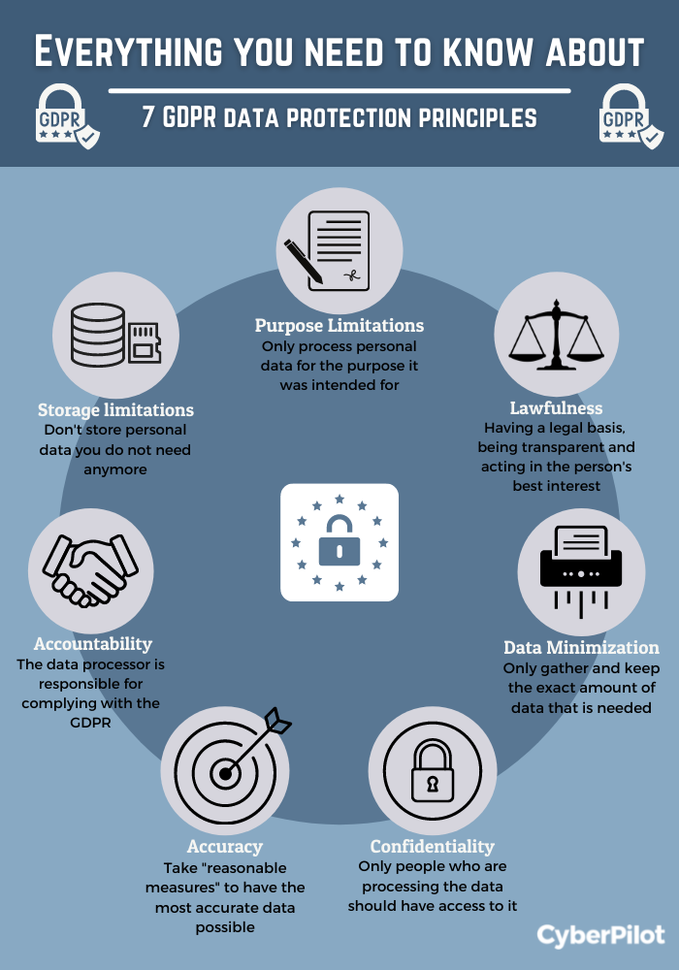

Slide 5
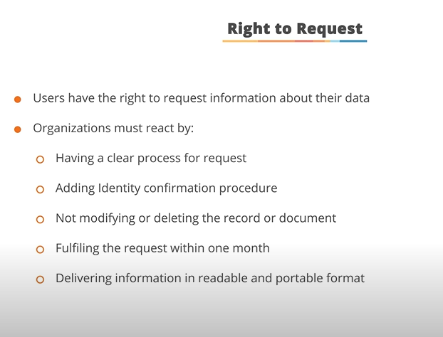

Slide 6
Regulation applies to:
Anyone who collects data
Anyone who processes or analyses data like segmenting a list based on the data or sending a personalized offer
Any one who records data (including the third party providers)
Companies have to upfront how to use their personal data
Use of data in CRM.
Sharing of data with third parties

Slide 7
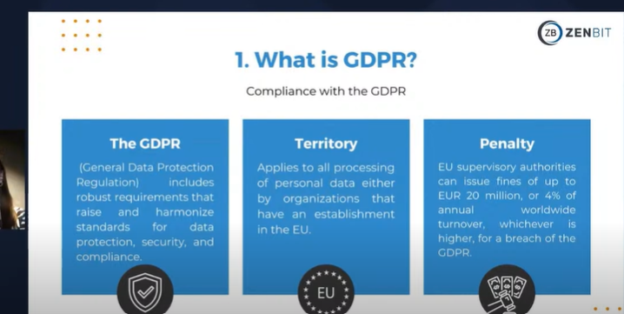

Slide 8
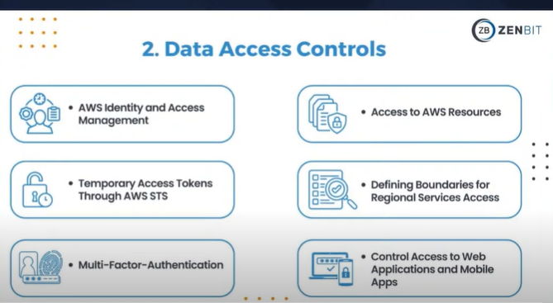

Slide 9
AWS Security Token:
AWS Security Token Service is an Amazon Web Services (AWS) service that allows you to get temporary security credentials (up to 1 hour) to users who need access to AWS resources. STS enables secure cross-account access and short-term, limited privilege credentials for applications that use AWS Identity Access Management

Slide 10
USE Caes of STS:
AWS STS use cases:
AWS Secure Token service covers the following use cases:
It allows you to temporarily assume AWS IAM roles in the same AWS account or cross-account

Slide 11
Even Though --→ if you are using different clouds they will not give you any Gurantee ….about Security.
All Cloud Providers will use Shared Responsibilty Model.
AWS Is responsible for Global Protection .

Slide 12
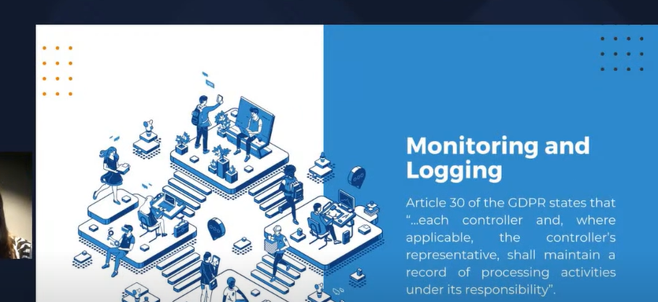

Slide 13
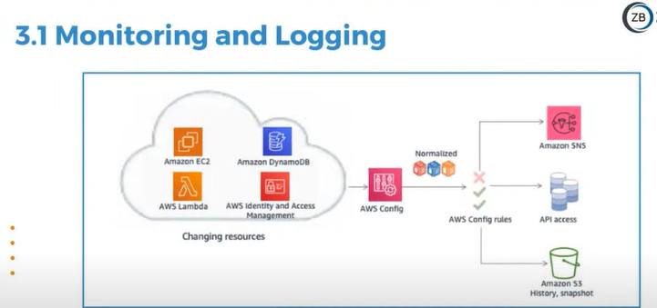

Slide 14
AWS Config:
AWS Config is a service that allows you to:
AWS Config is a service provided by Amazon Web Services (AWS) that empowers you to evaluate, review, and assess the configurations of your AWS resources. It persistently monitors and records the configuration changes that happen inside your AWS environment, giving insights into resource configuration history and encouraging compliance, security, and operational best practices.

Slide 15
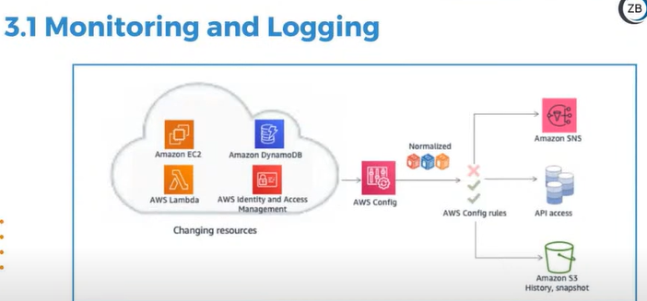

Slide 16
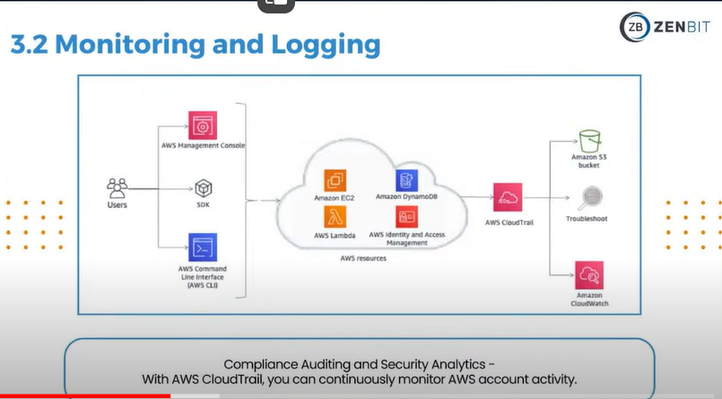

Slide 17
SDK
AWS provides SDKs for many popular technologies and programming languages. They make it easier for you to call AWS services from within your applications in that language or technology. Additionally, AWS also offers SDKs for AWS SaaS offerings so you can use them more efficiently in your code.
AWS SDK for Java is the set of the APIs that can enables the developers to interact with the ASW services. The SDK can provides the comprehensive set of the APIs for AWS services such as the Amazon S3, Amazon EC2, Amazon RDS and more. AWS SDK for java can be designed to be simple and easy to use. Making it an excellent choice for the java developers who want to build the cloud based applications.

Slide 18
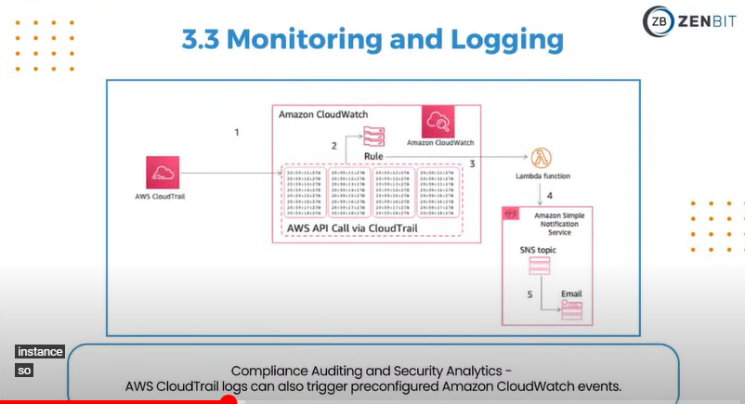

Slide 19
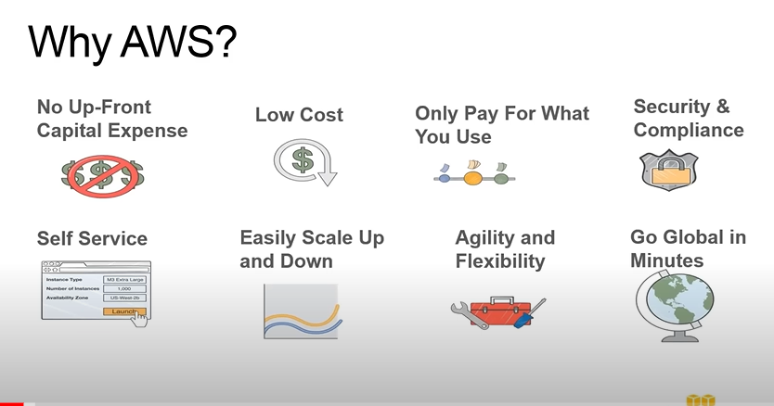
HIPAA Compliance:

Slide 21
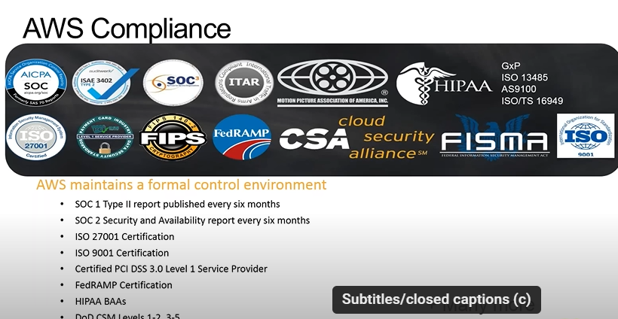

Slide 22
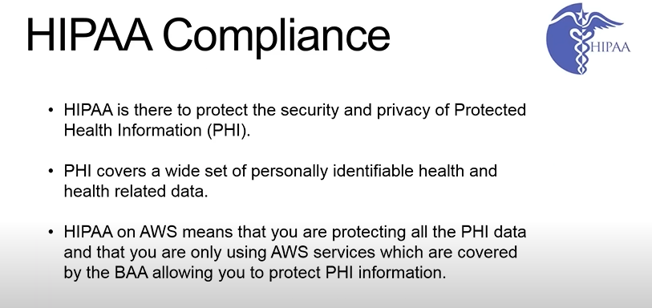

Slide 23
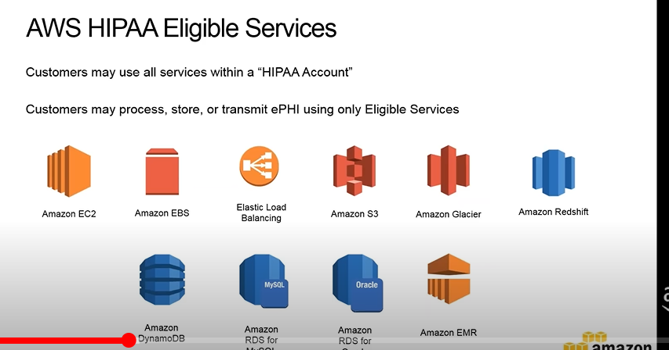

Slide 24
BAA:
In the context of HIPAA (Health Insurance Portability and Accountability Act), BAA stands for Business Associate Agreement.
A Business Associate Agreement is a contract between a HIPAA-covered entity (such as a healthcare provider) and a business associate (a third party that handles protected health information, or PHI). The agreement outlines the responsibilities of the business associate to ensure that PHI is protected in accordance with HIPAA regulations.

Slide 25
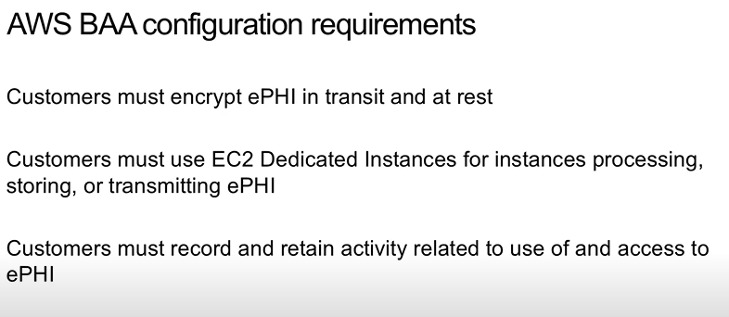

Slide 26
EPHI:
encryption of ePHI (Electronic Protected Health Information) is a key safeguard under the HIPAA Security Rule,

Slide 27
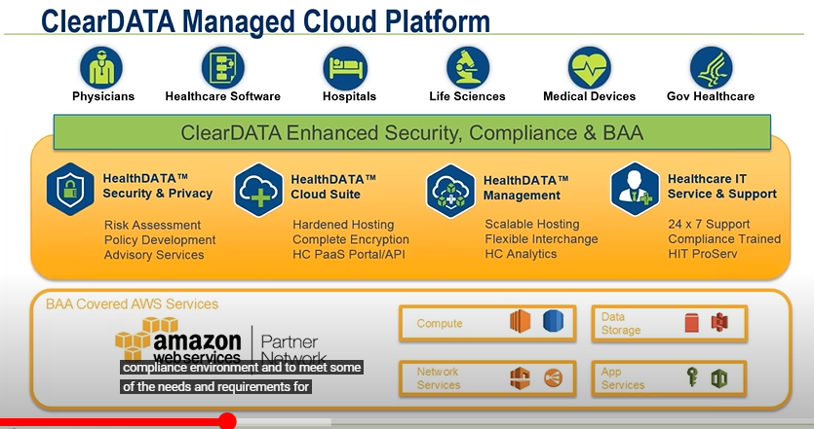

Slide 28
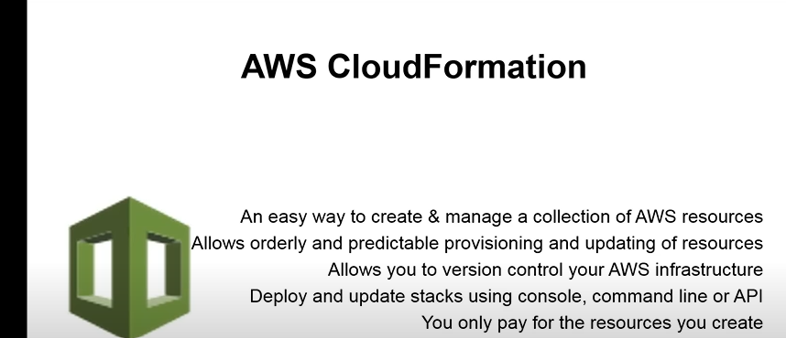

Slide 29
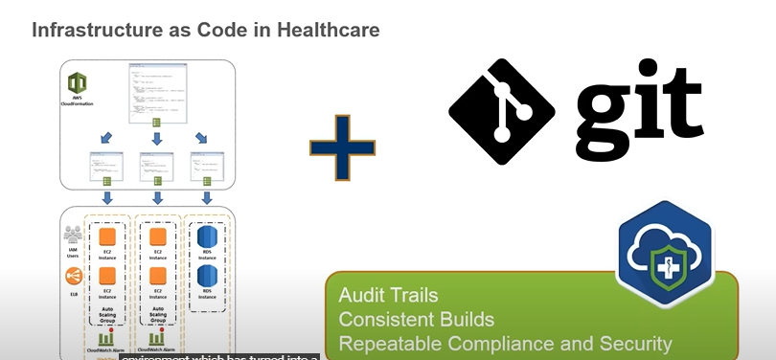

Slide 30
